Slide 1
Data Exploration
4 original datasets from kaggle: tracks - contains track features charts - contains chart position of tracks, track ids and artist ids artists - contains artists and their popularity recommended artists - contains artists recommendations for artists by ids
Notes:
Introduction to use case, goal, selection of data set

Slide 2
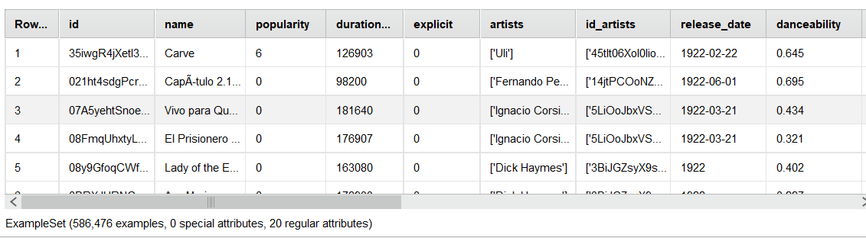
Tracks Data
Notes:
Introduction to use case, goal, selection of data set

Slide 3
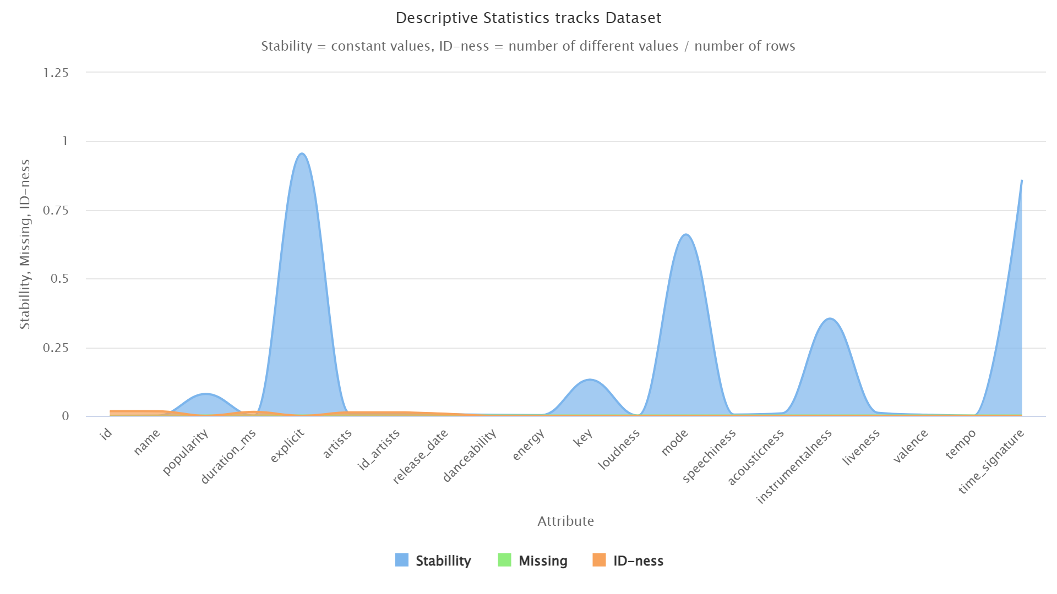
ARTISTS Data
Notes:
Introduction to use case, goal, selection of data set

Slide 4
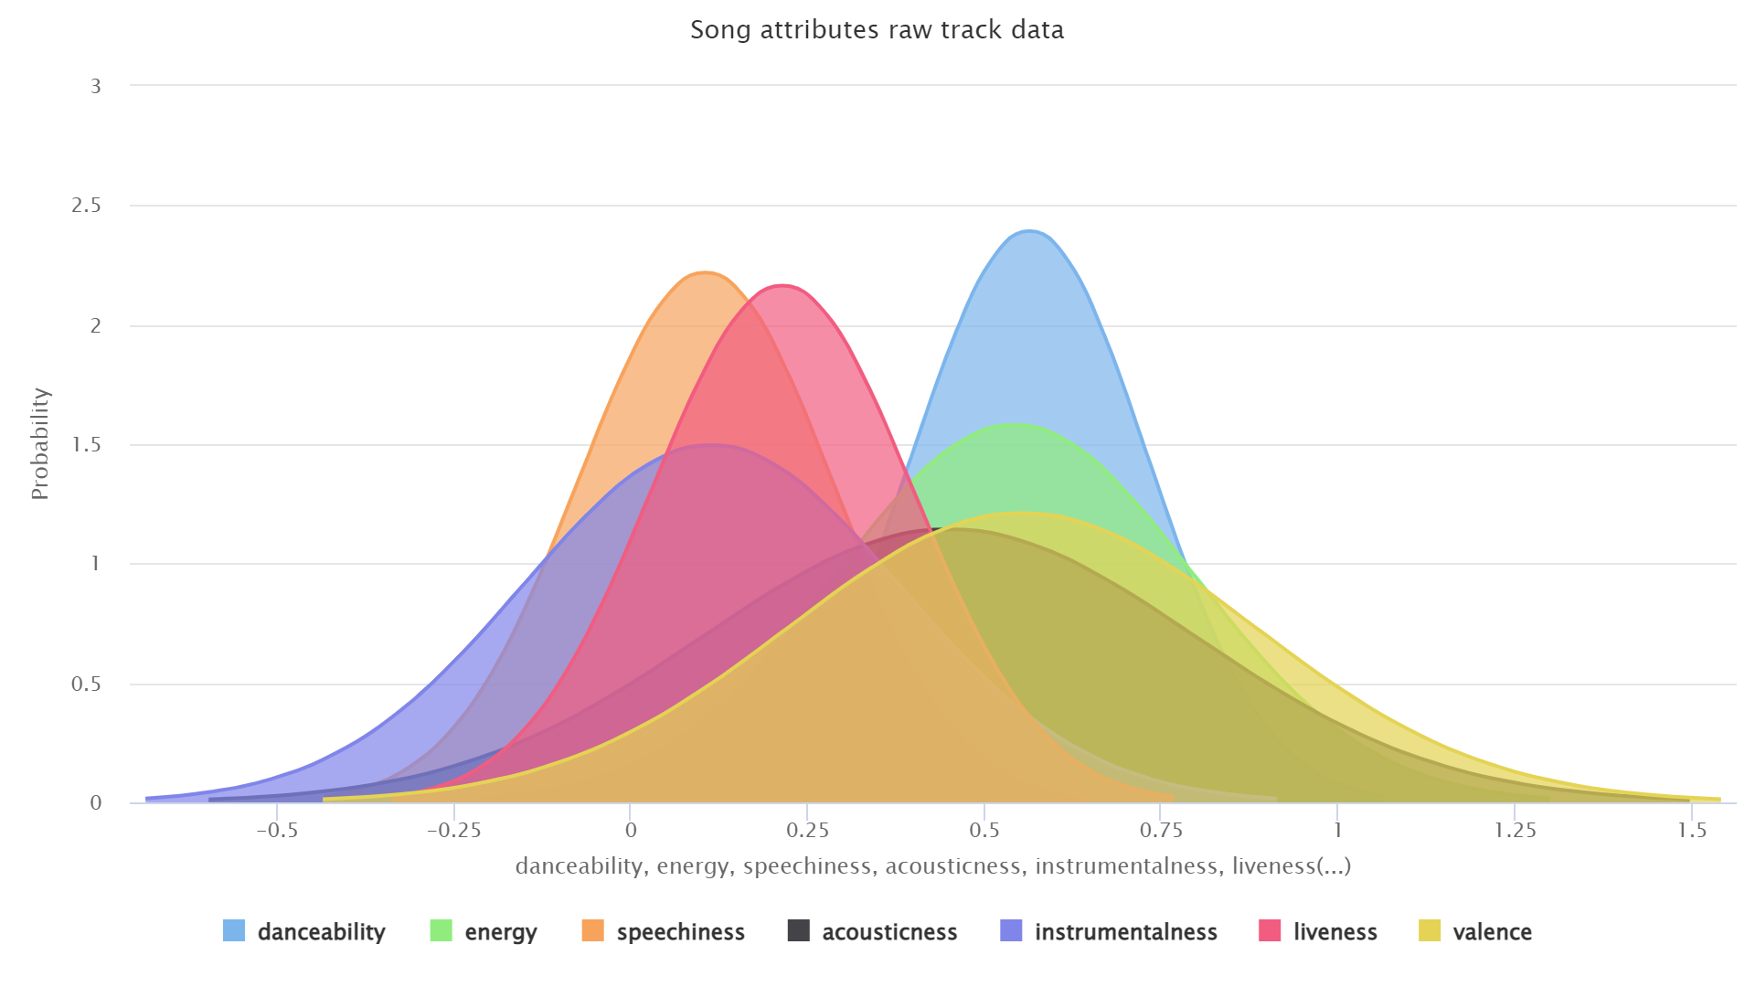
Tracks Data
Notes:
Introduction to use case, goal, selection of data set

Slide 5
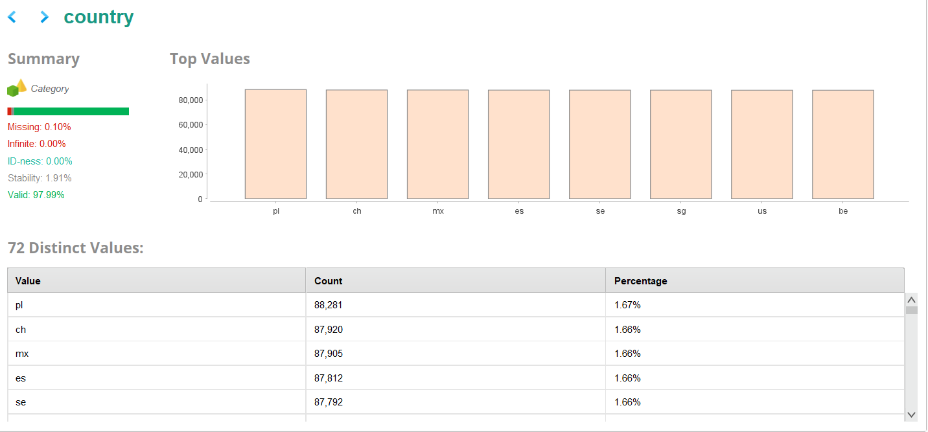
Tracks Data
Notes:
Introduction to use case, goal, selection of data set

Slide 6
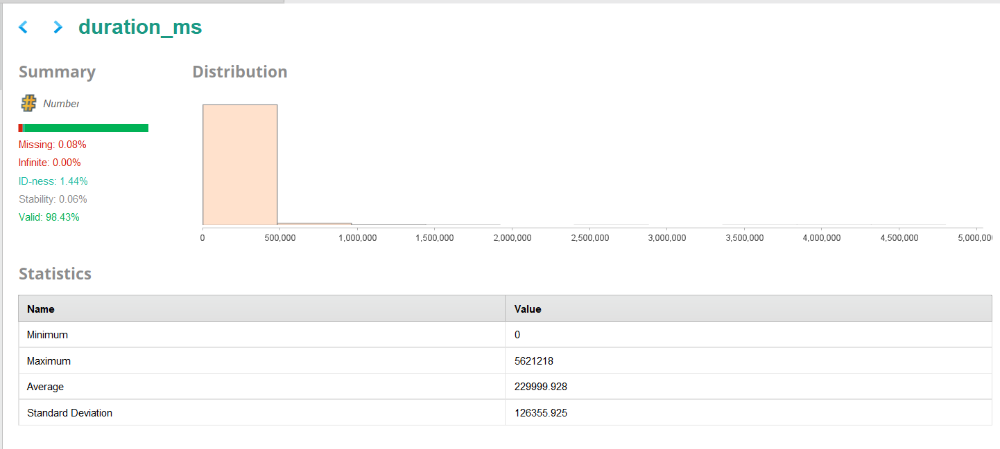
Tracks Data
Notes:
Introduction to use case, goal, selection of data set

Slide 7
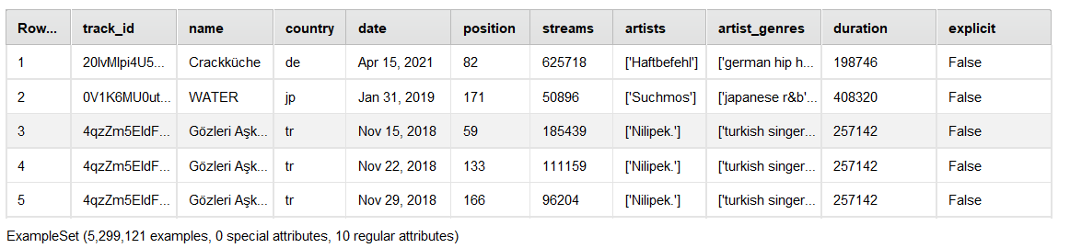
cHARTS Data
Notes:
Introduction to use case, goal, selection of data set

Slide 8
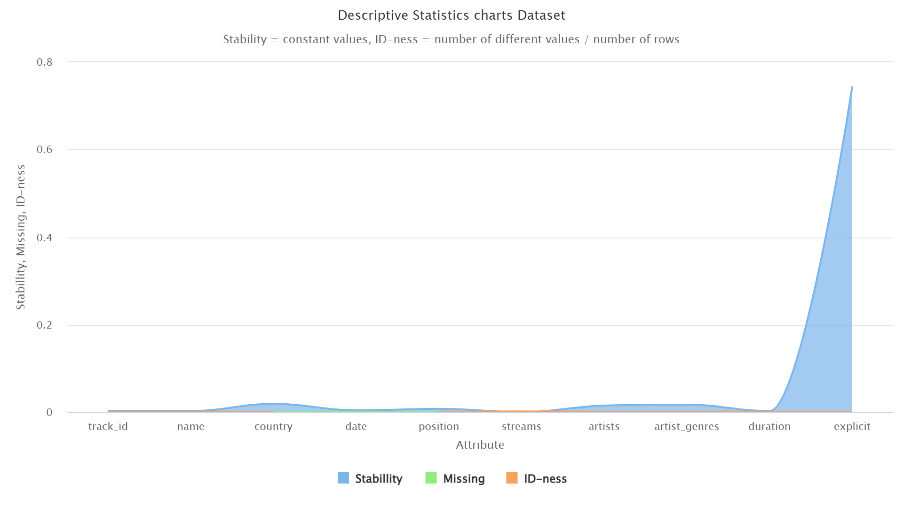
ARTISTS Data
Notes:
Introduction to use case, goal, selection of data set

Slide 9
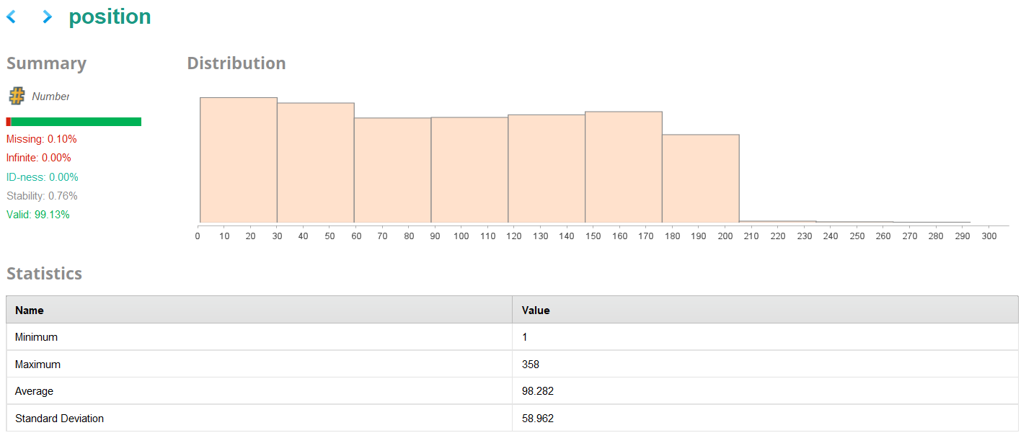
ARTISTS Data
Notes:
Introduction to use case, goal, selection of data set

Slide 10
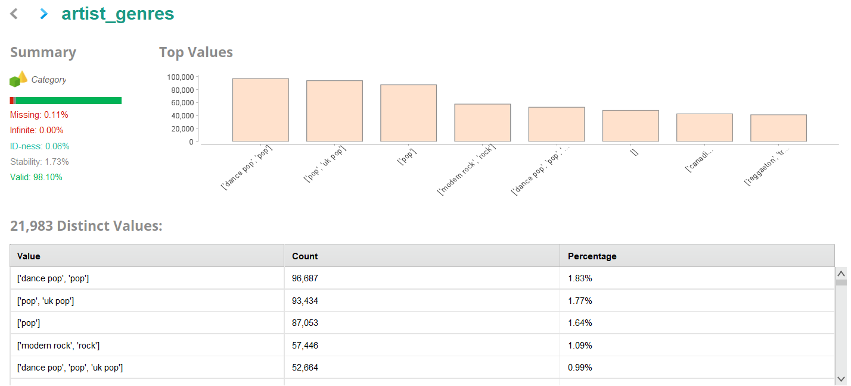
ARTISTS Data
Notes:
Introduction to use case, goal, selection of data set

Slide 11
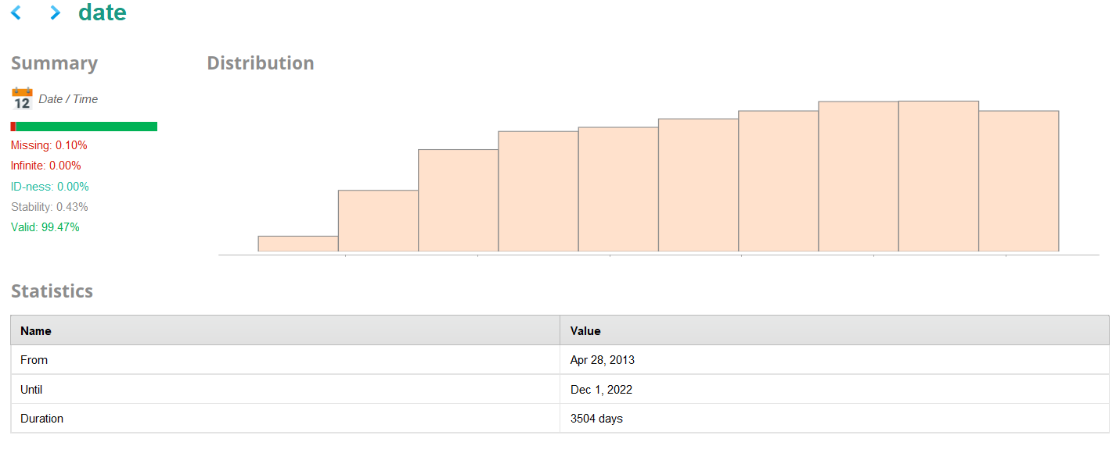
ARTISTS Data
Notes:
Introduction to use case, goal, selection of data set

Slide 12
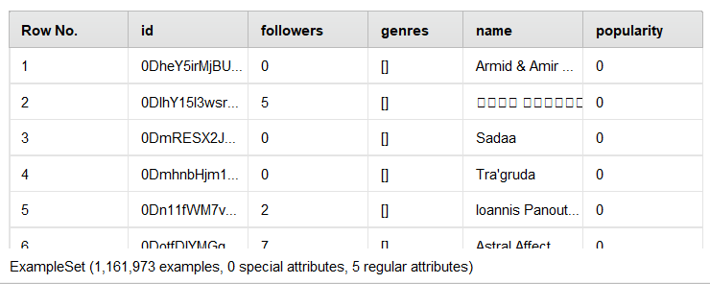
ARTISTS Data
Notes:
Introduction to use case, goal, selection of data set

Slide 13
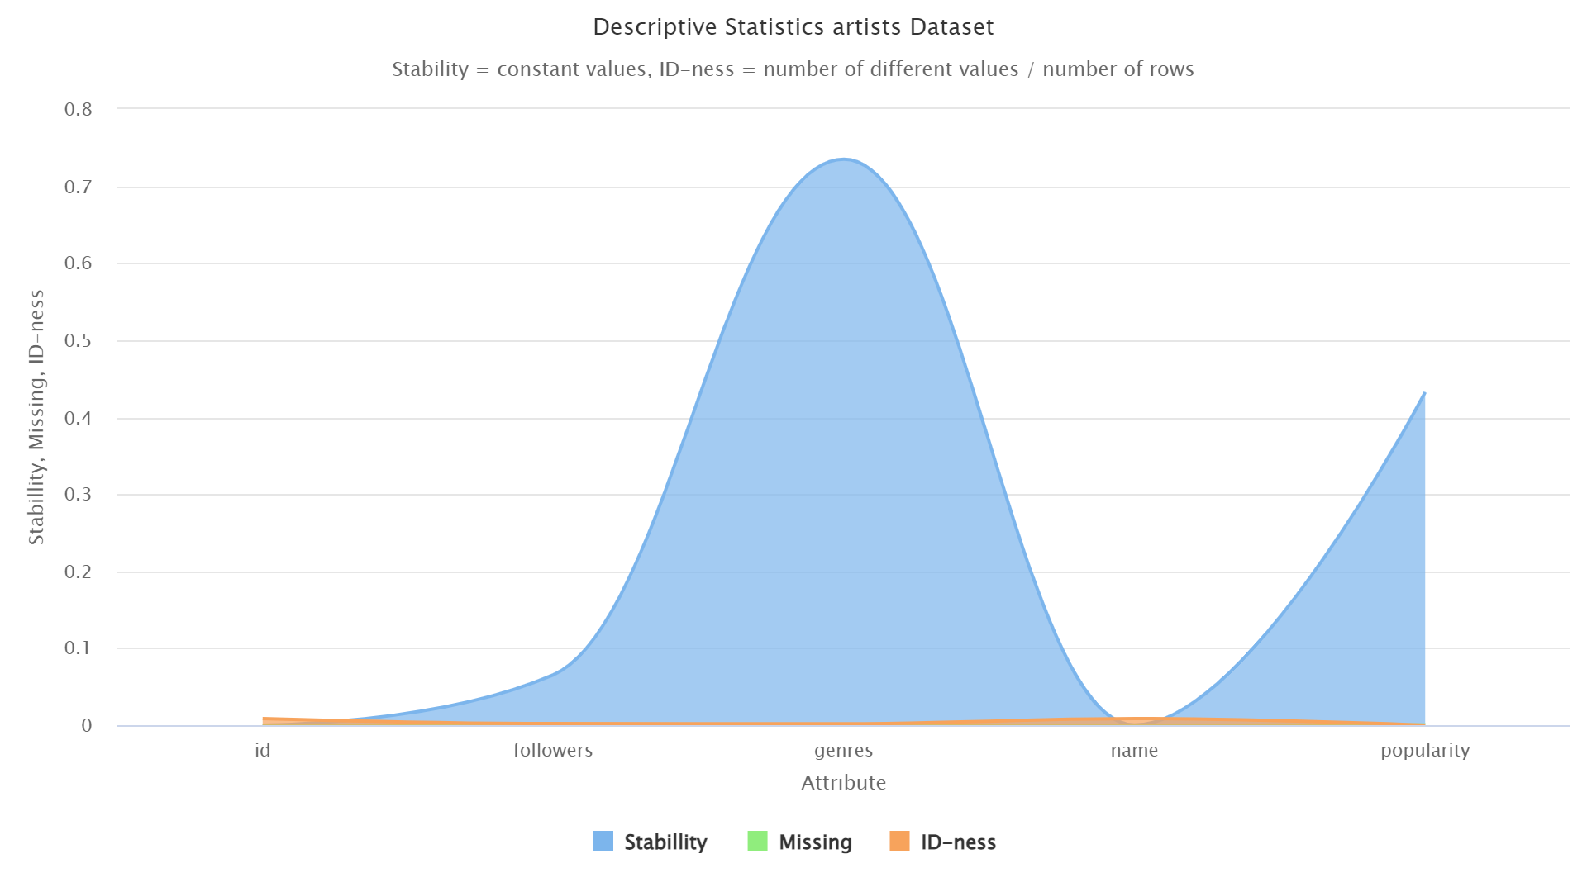
ARTISTS Data
Notes:
Introduction to use case, goal, selection of data set

Slide 14
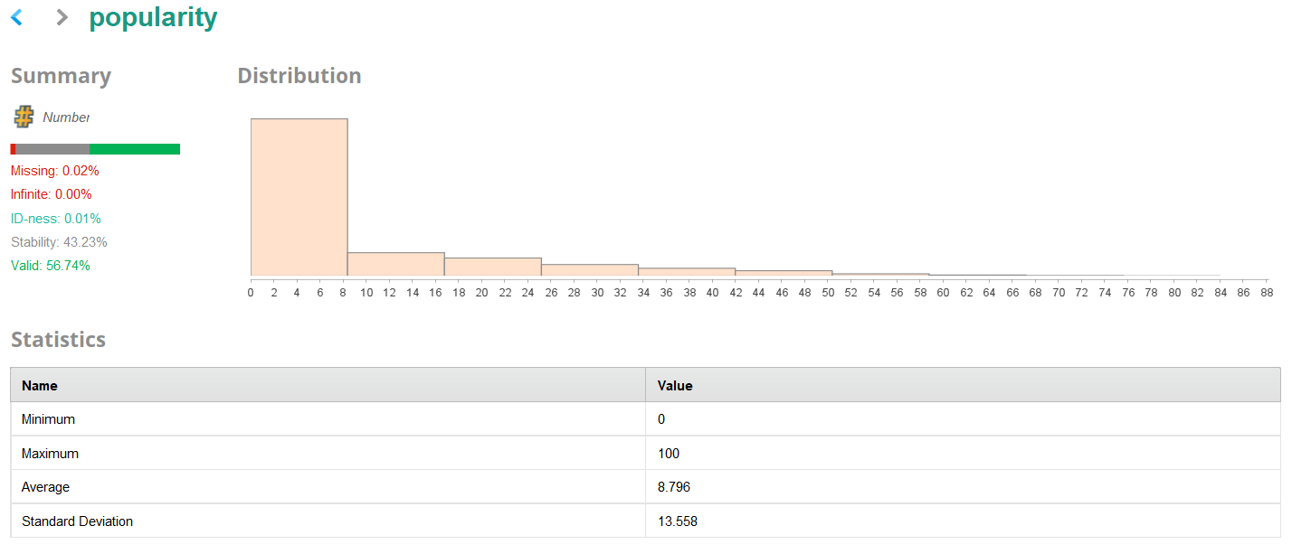
ARTISTS Data
Notes:
Introduction to use case, goal, selection of data set

Slide 15
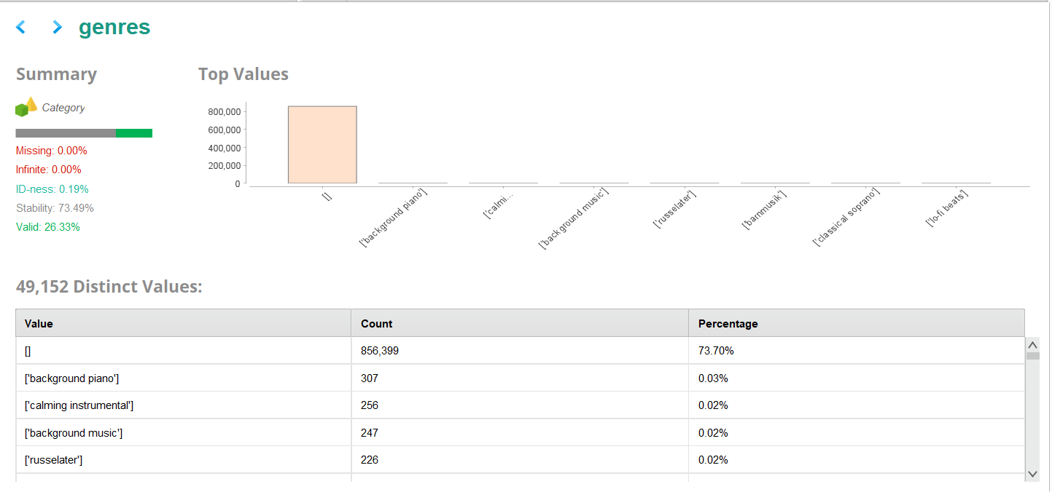
ARTISTS Data
Notes:
Introduction to use case, goal, selection of data set

Slide 16
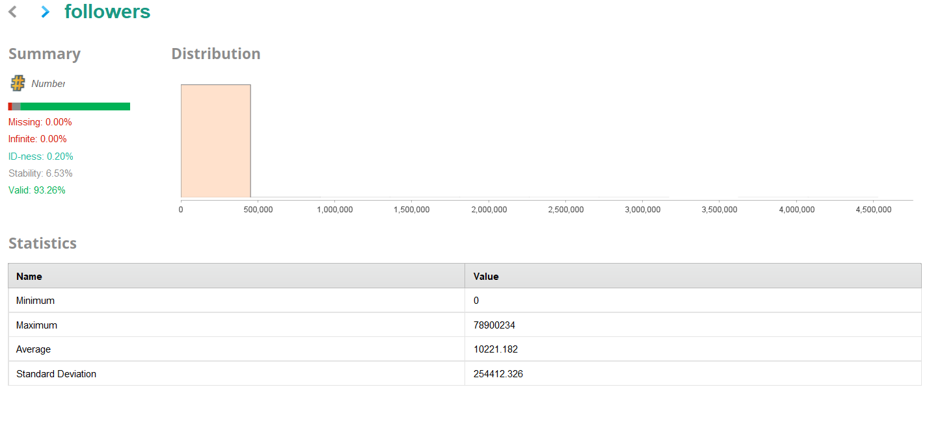
ARTISTS Data
Notes:
Introduction to use case, goal, selection of data set

Slide 17
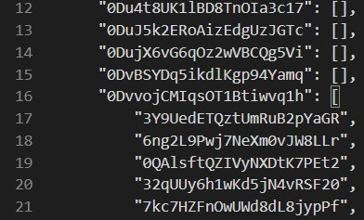
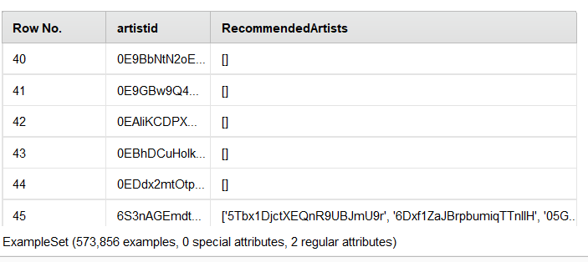
Recommended Artists Data
Notes:
Introduction to use case, goal, selection of data set

Slide 18
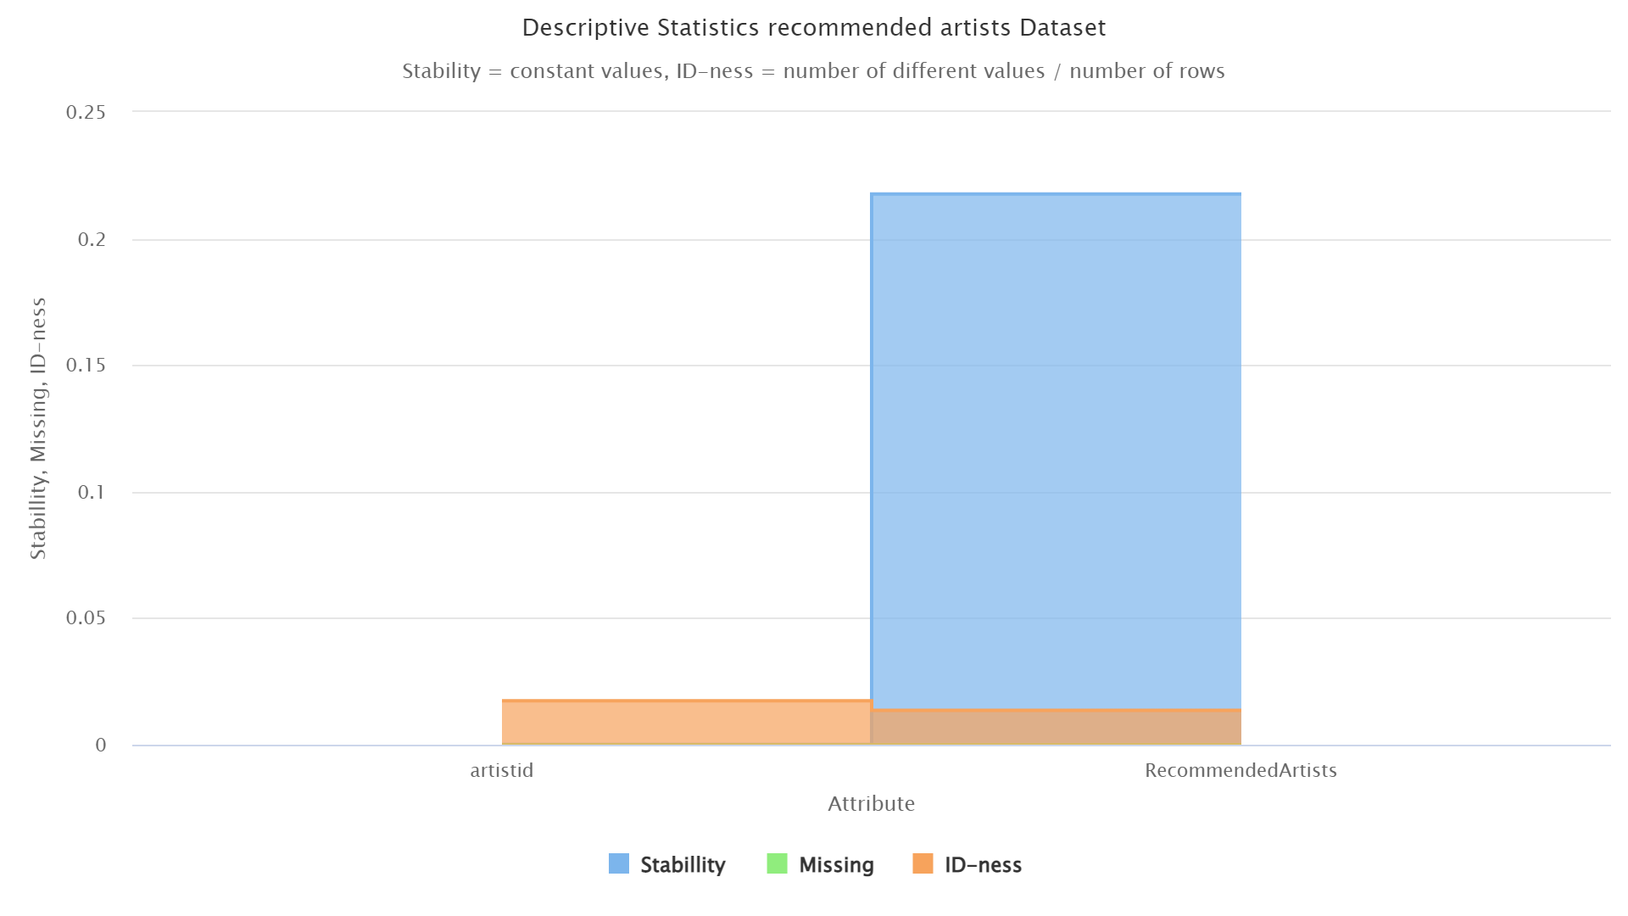
ARTISTS Data
Notes:
Introduction to use case, goal, selection of data set

Slide 19
Data Exploration Insights
Some data points are missing (genres in artist dataset) – fix through joining and data engineering
Either popularity or chartsposition could work for generating a top song label (feature engineering) Distributions are right skewed and should be normalized
Country and date information in datasets
Notes:
Introduction to use case, goal, selection of data set

Slide 20
Data Engineering
Iterative process to gain 2 main datasets: 1. “Fin Table” Dataset - track ids, popularity, charts position and specific musical features calculated by Spotify. Created by joining track and charts datasets from Kaggle in SQL (size issue with RapidMiner). 2. Cleanset Dataset – training data for modeling to see which features impact a “Top Song” in which way
“Top Song” label needs to be defined: 1. Top song by popularity – track popularity ≥85 (out of 100) = Top Song. 2. Top song by charts position – lowest charts position of a track ≤30 = Top Song. (We disregard different countries for our evaluation and take the lowest / highest measure for all countries)
Notes:
Introduction to use case, goal, selection of data set

Slide 21
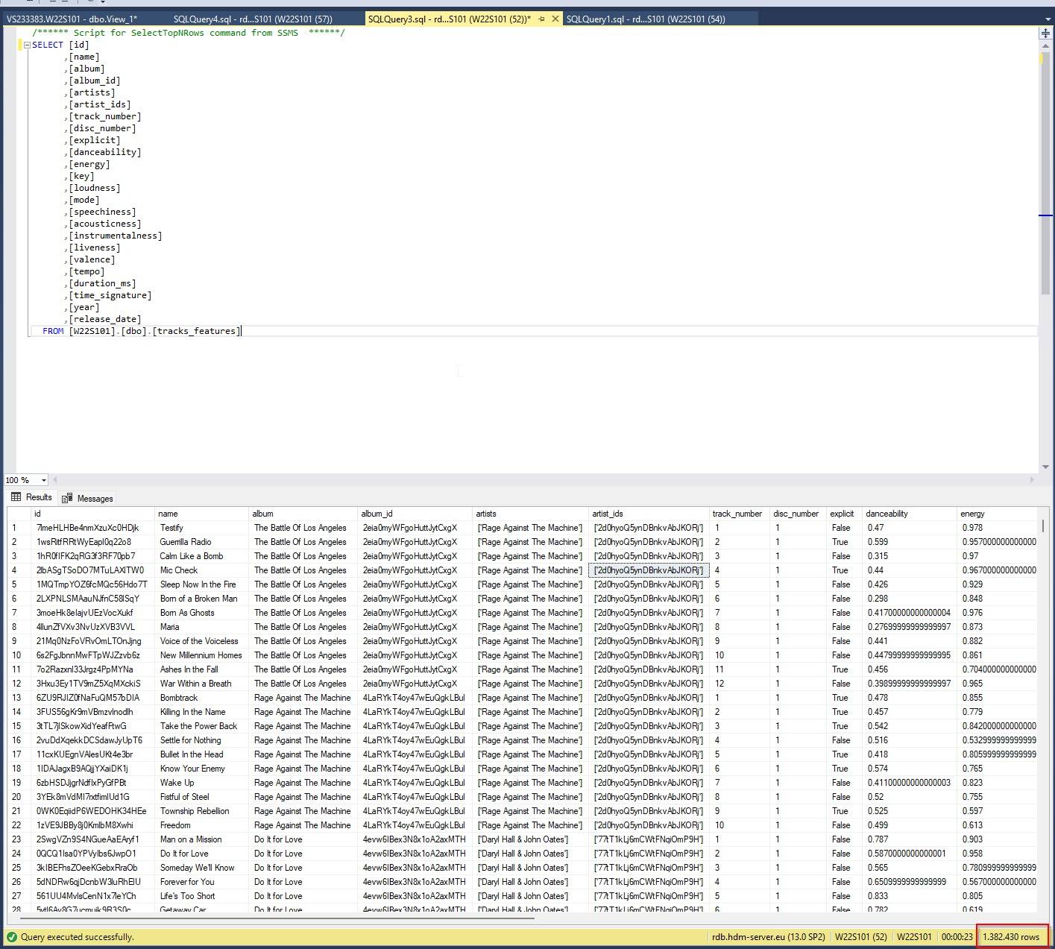
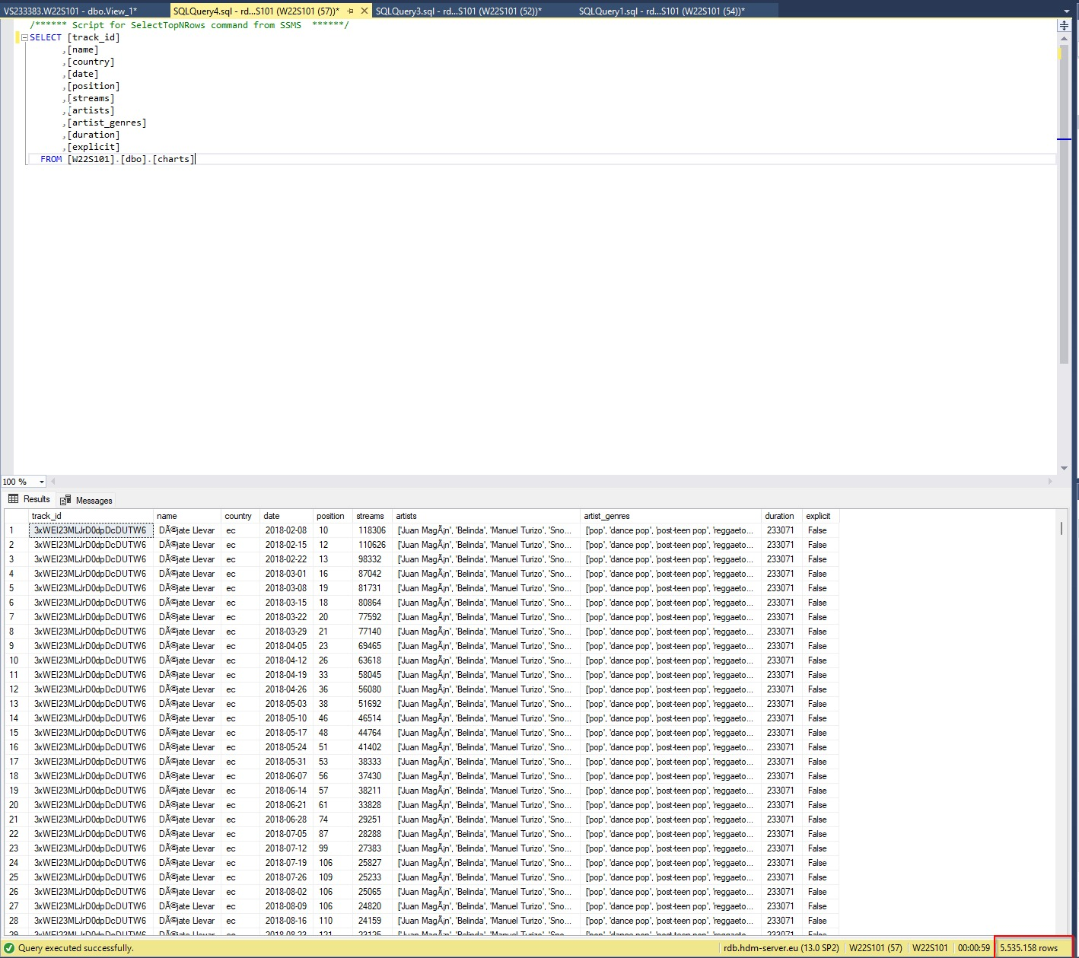
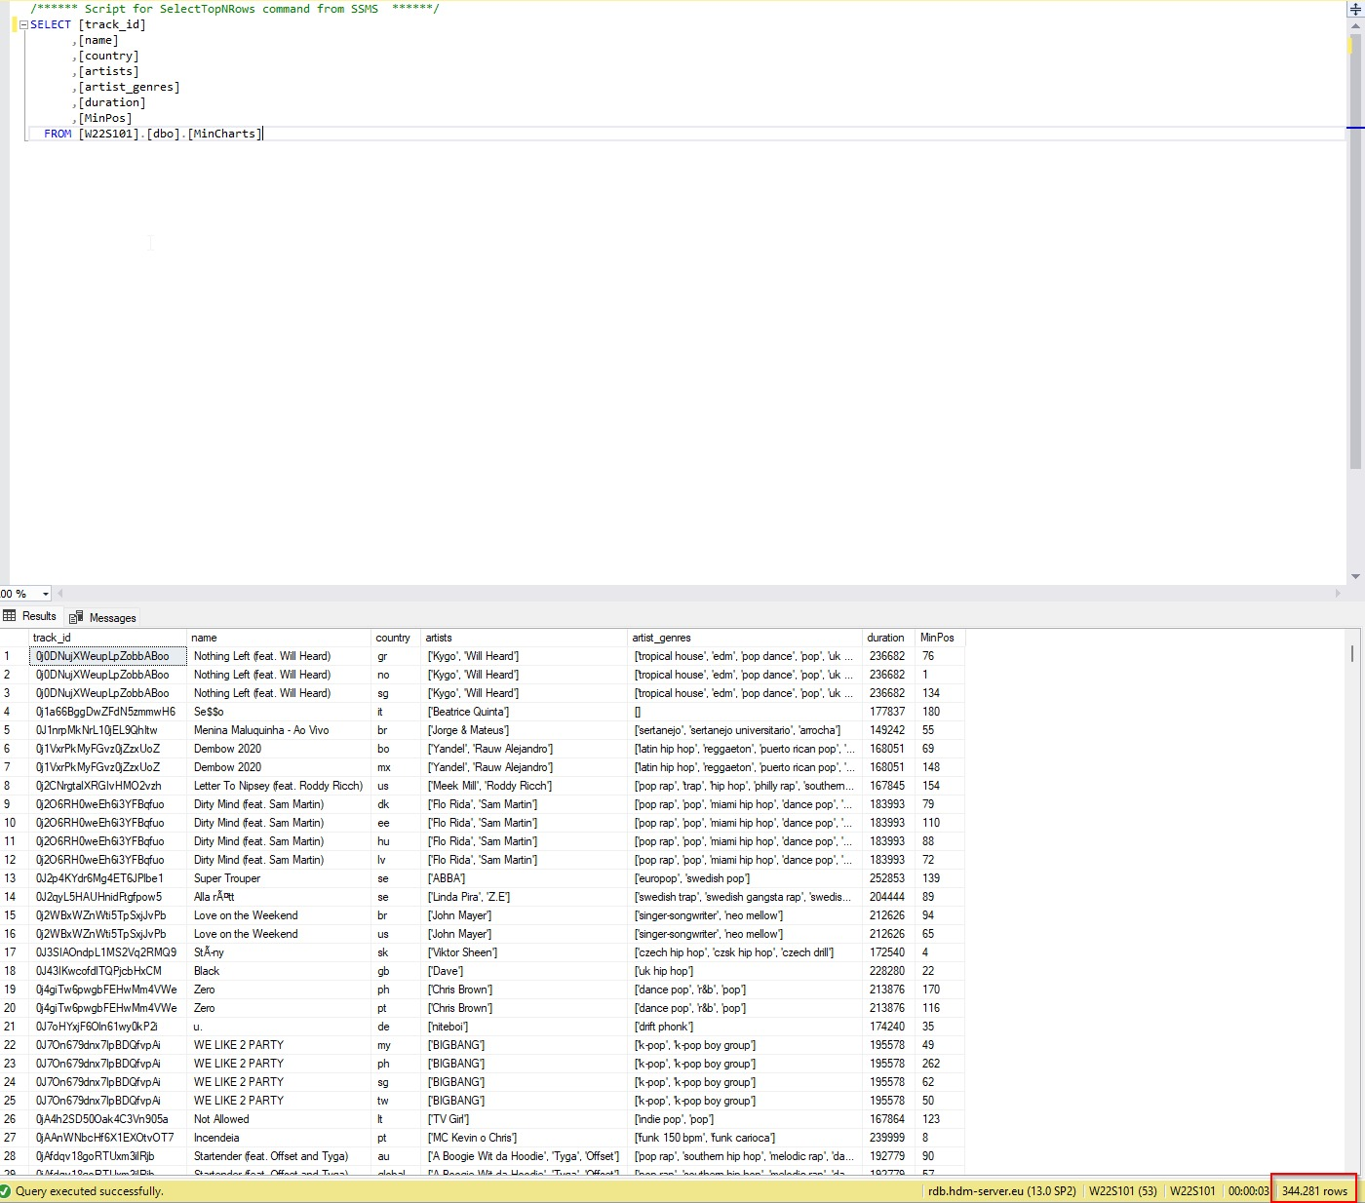
Create Fin Table
Load Data in SQL
Aggregate min(ChartsPos)
reduce 5 mio. to 344281 Rows
Join Charts with Track dataset to generate Fin Table
Notes:
Introduction to use case, goal, selection of data set

Slide 22
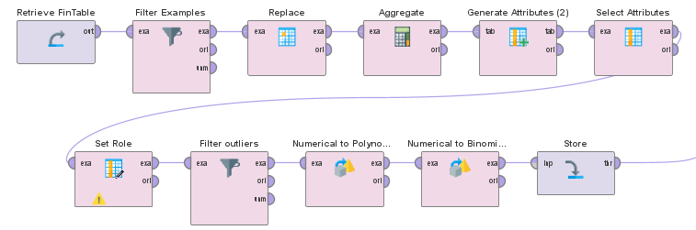
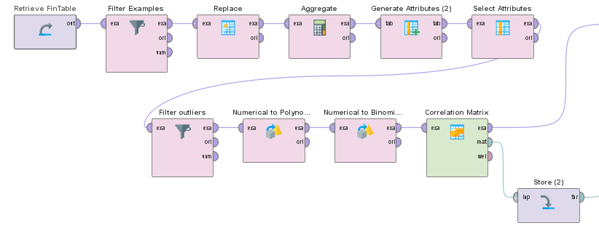
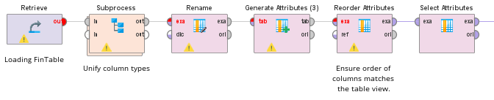
Data Wrangling and additional exploration Fin Table
Iterative process
Inspected Dataset for missing and wrong values to replace
Filtered outliers
Created Top Song label by popularity and by min(chartsPos) to compare
Notes:
Source: Forbes
https://www.forbes.com/sites/eamonnforde/2022/01/19/spotify-comfortably-remains-the-biggest-streaming-service-despite-its-market-share-being-eaten-into/?sh=6f71a5134743

Slide 23
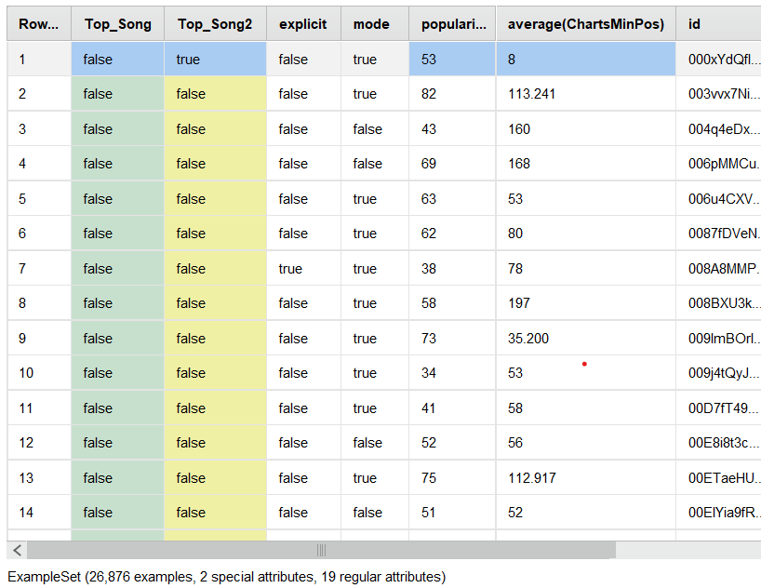
Fin Table
Notes:
Source: Forbes
https://www.forbes.com/sites/eamonnforde/2022/01/19/spotify-comfortably-remains-the-biggest-streaming-service-despite-its-market-share-being-eaten-into/?sh=6f71a5134743

Slide 24
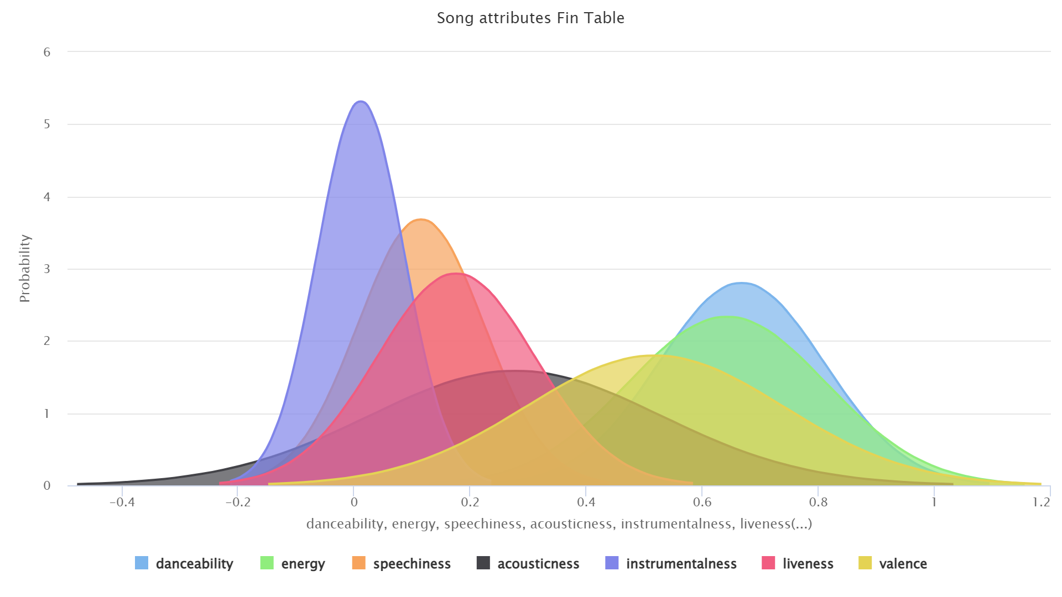
Notes:
Source: Forbes
https://www.forbes.com/sites/eamonnforde/2022/01/19/spotify-comfortably-remains-the-biggest-streaming-service-despite-its-market-share-being-eaten-into/?sh=6f71a5134743

Slide 25
Tracks Data
Notes:
Introduction to use case, goal, selection of data set

Slide 26
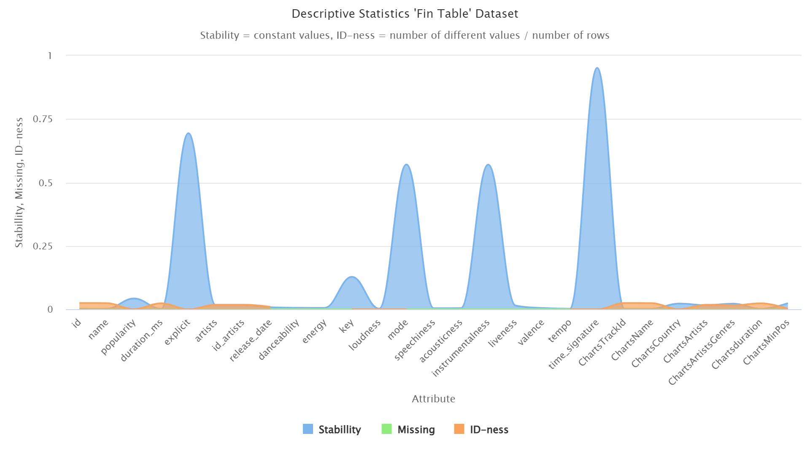
Notes:
Source: Forbes
https://www.forbes.com/sites/eamonnforde/2022/01/19/spotify-comfortably-remains-the-biggest-streaming-service-despite-its-market-share-being-eaten-into/?sh=6f71a5134743

Slide 27
ARTISTS Data
Notes:
Introduction to use case, goal, selection of data set

Slide 28
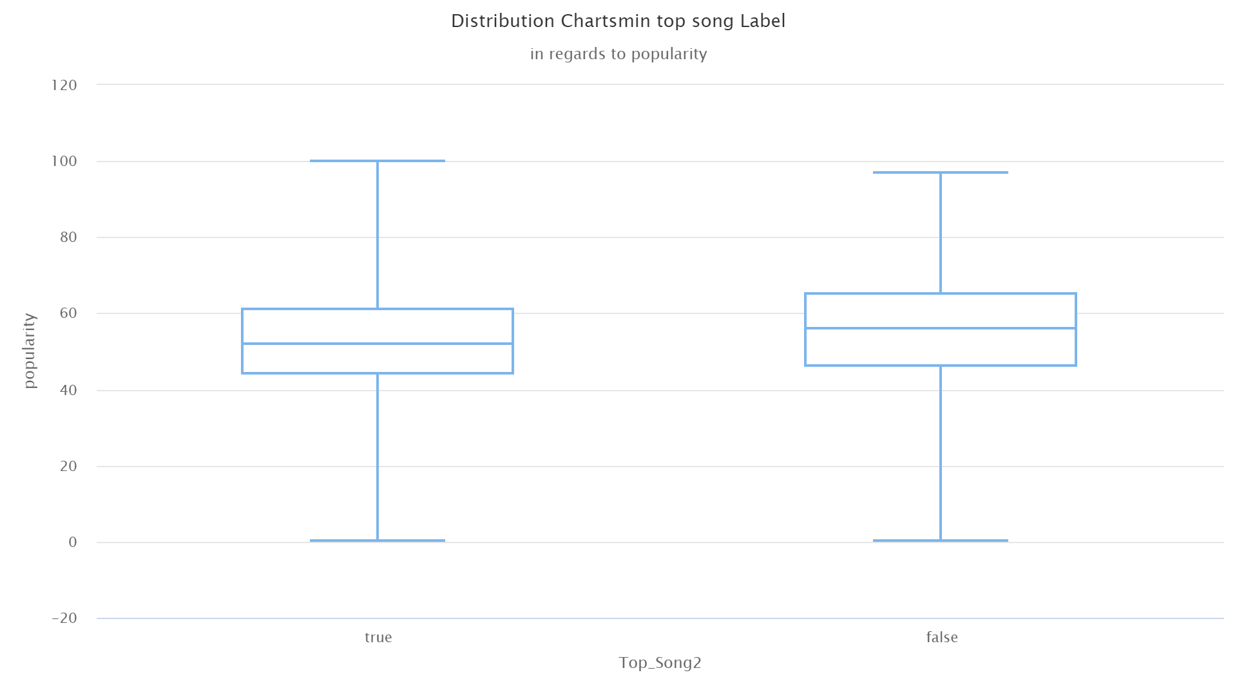
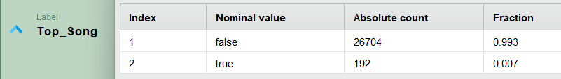
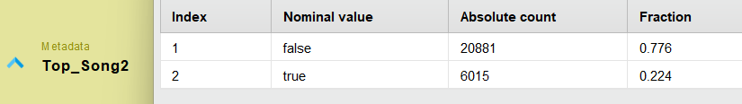
Comparison Top Song Label by Popularity and MINimum Charts Position
Notes:
Introduction to use case, goal, selection of data set

Slide 29
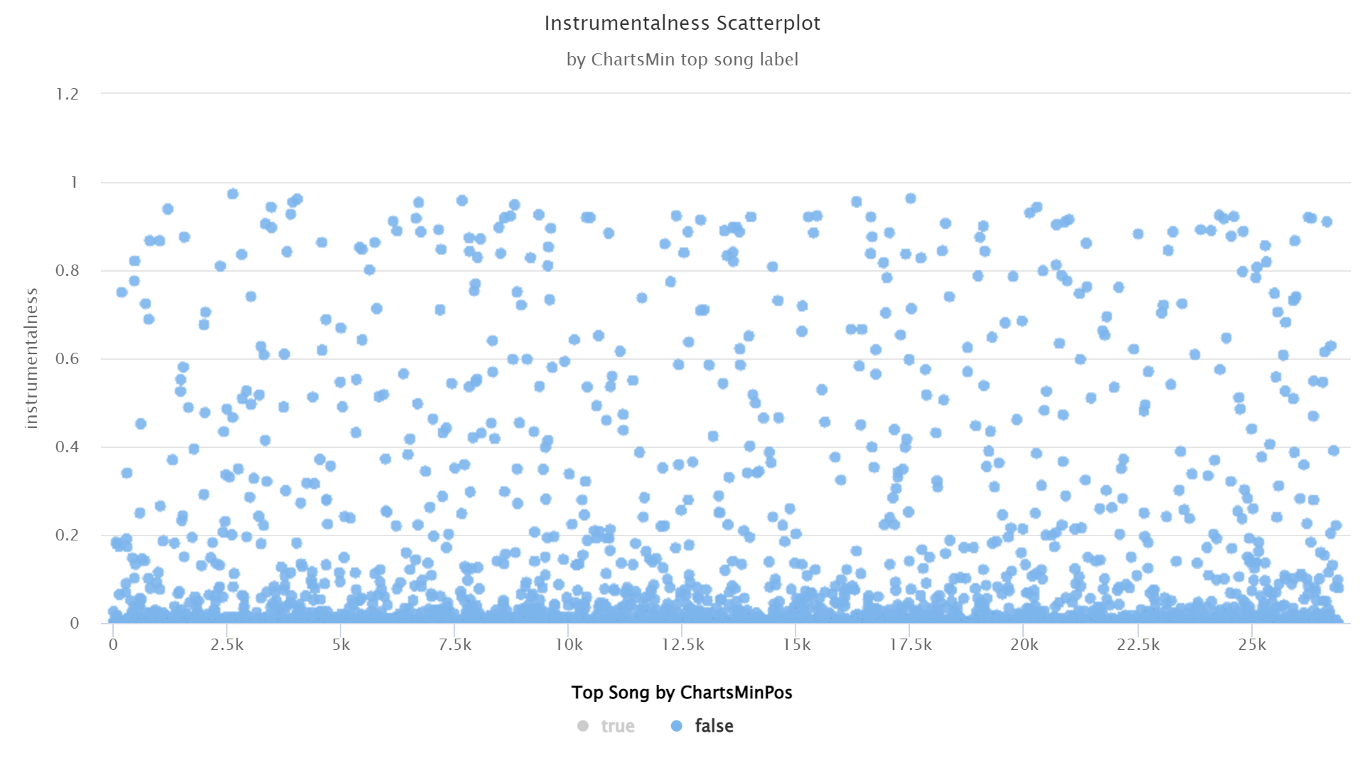
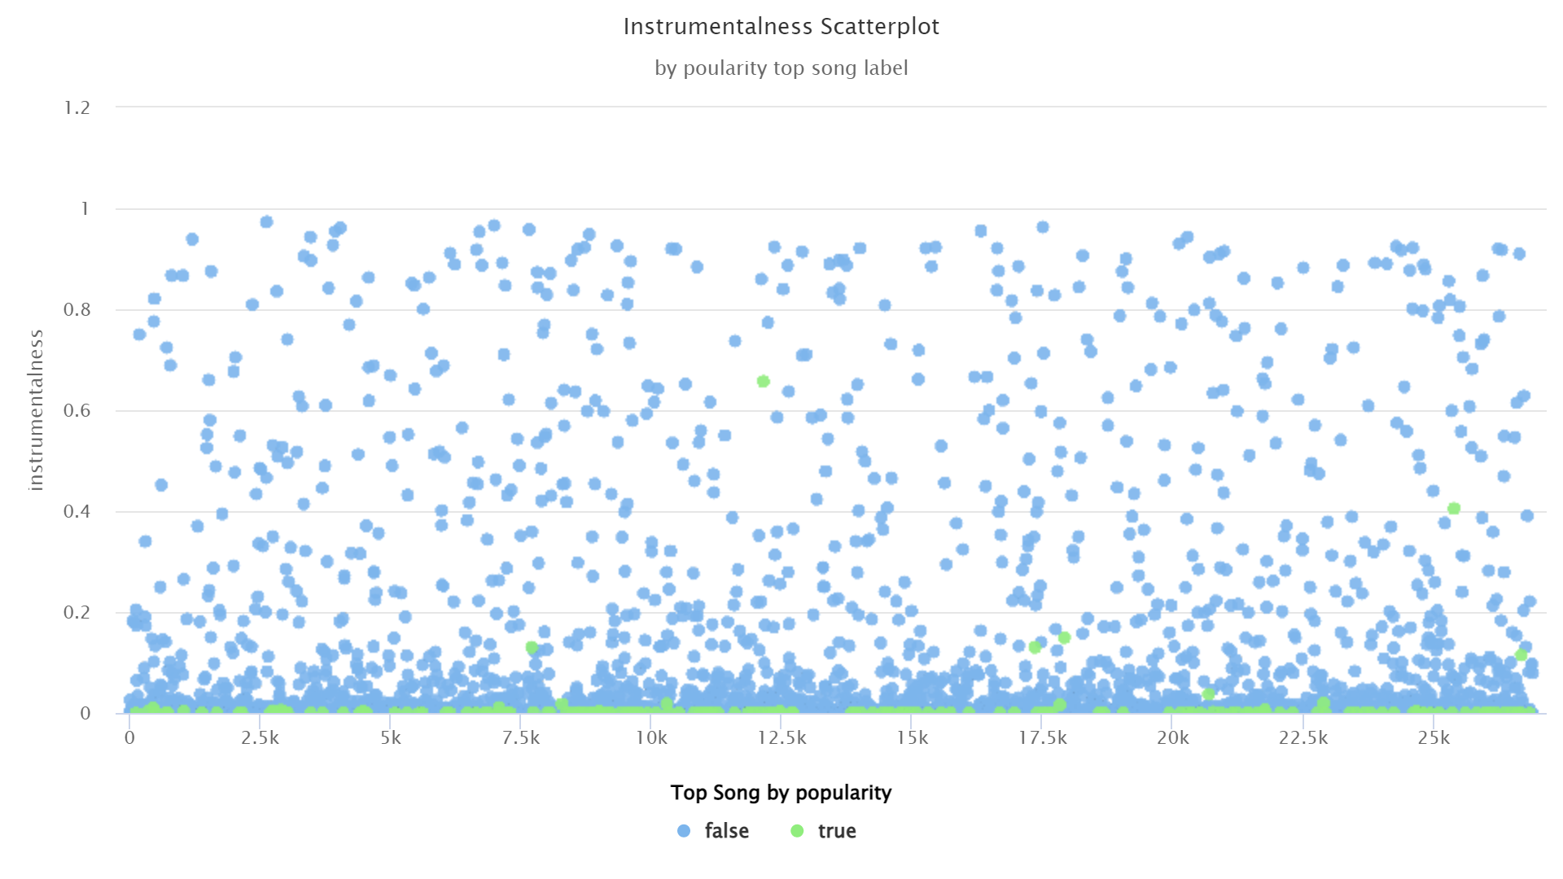
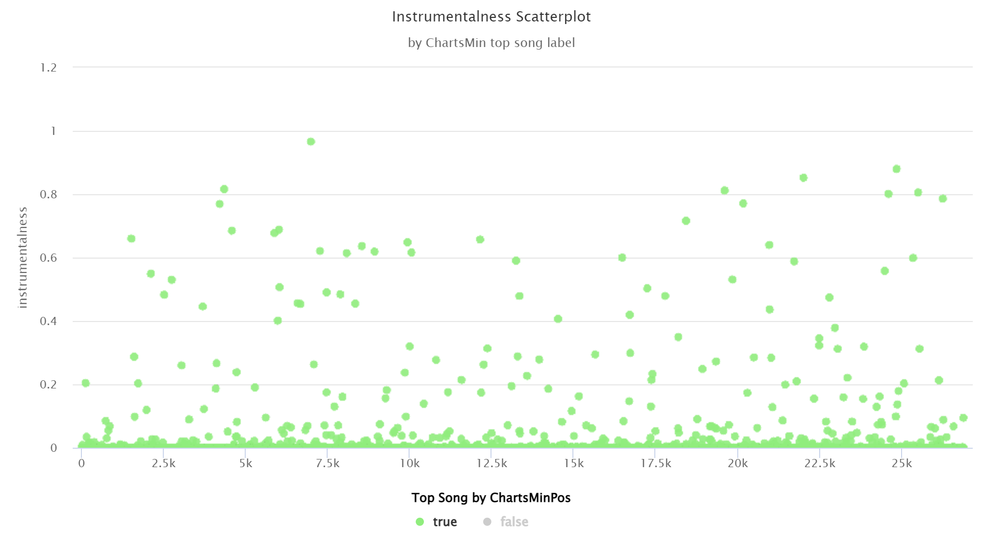
Notes:
Source: Forbes
https://www.forbes.com/sites/eamonnforde/2022/01/19/spotify-comfortably-remains-the-biggest-streaming-service-despite-its-market-share-being-eaten-into/?sh=6f71a5134743

Slide 30
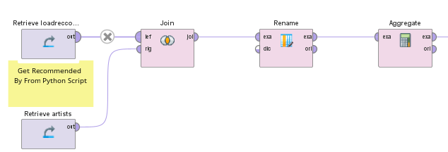
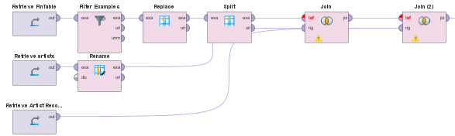
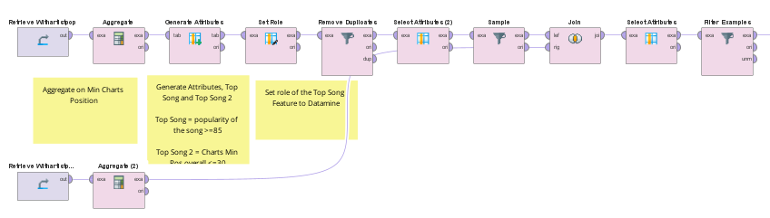
Final Engineering to Create Training Data “Cleanset”
1. Join artists and recommended artists
2. Join Fin Table, previous join and artists data
3. Create Cleanset with Top Song label by min(chartsPos). Balanced label by downsampling to 6000 each
Notes:
Source: Forbes
https://www.forbes.com/sites/eamonnforde/2022/01/19/spotify-comfortably-remains-the-biggest-streaming-service-despite-its-market-share-being-eaten-into/?sh=6f71a5134743

Slide 31
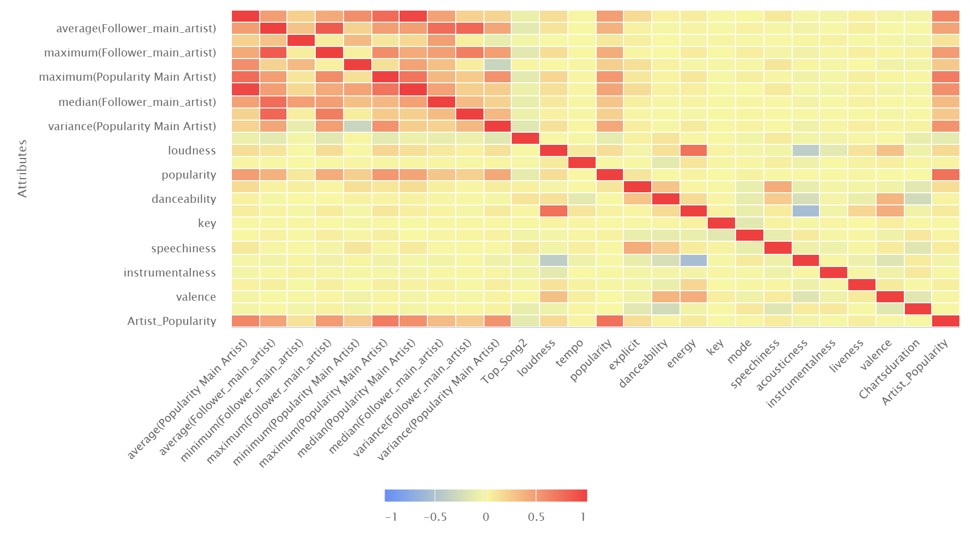
Notes:
Source: Forbes
https://www.forbes.com/sites/eamonnforde/2022/01/19/spotify-comfortably-remains-the-biggest-streaming-service-despite-its-market-share-being-eaten-into/?sh=6f71a5134743

